Slide 1
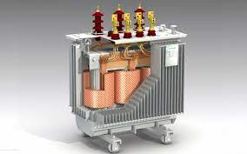
Introduction to Transformer
What will we learn from this lecture?
- What is a transformer?
- Type of transformer
- Core type construction
- Shell type construction

Slide 2
What do we mean by word Transformer?
Arrangement of two electrically isolated coils in such a way that the time varying flux due to one of them causes an emf to induced in the other, they are said to be form a transformer.

Slide 3
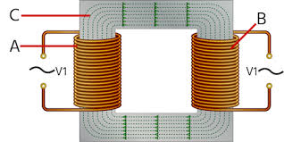
Here is a picture of a transformer:
Here,
A= Primary Windings
B= Secondary Windings
C= Mutual Flux

Slide 4
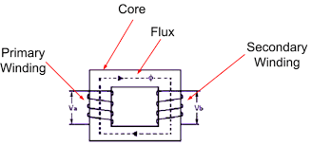
There are two type of Transformer construction:
Core Type Construction:
When primary and secondary coils split and wounded on both legs , it is called core type construction. It is applicable for high voltage application for having more space.

Slide 5
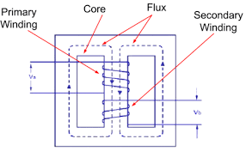
b) Shell Type Construction:
Primary and secondary coils wounded on same legs. It has less leakage flux.

Slide 6
Age of Existing Transformers
< 10 Years
11-29 Years
>30 Years

Slide 7

Thank you!

